Slide 1
Social Influence
Chapter16

Slide 2
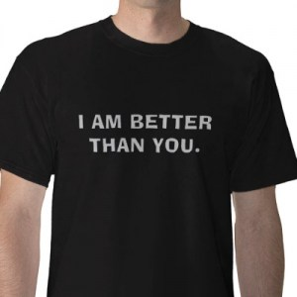
Social Behavior
Social comparison theory
  Actions
  Feelings
  Opinions
  Abilities
Media and body image
Hypothesis testing – psychological research in action
http://youtu.be/GMcfalMuHcI

Slide 3
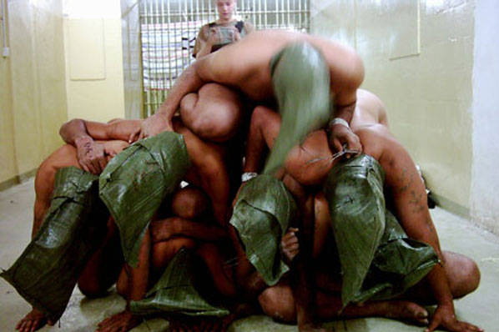
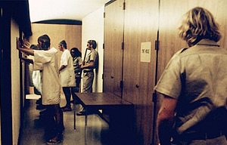
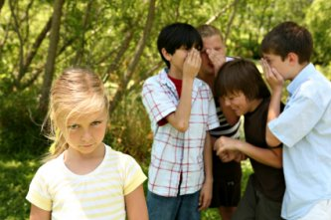
Social Behavior
Group conformity
  Phillip Zimbardo
  The Lucifer Effect – when good people do bad things
    Stanford Prison Experiment
    http://video.google.com/videoplay?docid=677084988379129606#
    Abu Ghraib
    http://mitworld.mit.edu/video/459

Slide 4
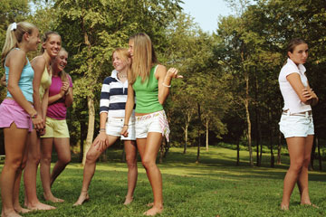
Social Behavior
Female relational aggression
  Exclusion
  Ignoring
  Malicious gossip and rumor spreading
  Taunts and insults
  Teasing
  Intimidation
  Manipulative affection
  Alliance building
  Cyberbullying

Slide 5
Social Behavior
Prejudice
  Negative emotional attitudes
    Racism
    Sexism
    Ageism
    Heterosexism
    Ableism
    Classism
Quotes
  If your lens is prejudice, you're wearing the wrong prescription
    ~Carrie Latet
  Prejudices are the chains forged by ignorance to keep men apart
    ~Countess of Blessington
  In overcoming prejudice, working together is even more effective than talking together
    ~Ralph W. Sockman
  Prejudice is the child of ignorance
    ~William Hazlitt
Tolerance

